Slide 2
Presentation title
Speaker Name
Title

Slide 3
Session Goals
Session Goal 1
  Session Goal sub text
  Session Goal sub text
Session Goal 2
  Session Goal sub text
  Session Goal sub text
Session Goal 3
  Session Goal sub text
  Session Goal sub text
This slide is required. Do NOT delete.
Please expand notes window at bottom of slide and read.
Then Delete this text box.
Notes:
This slide is required. Do NOT delete. This should be the first slide after your Title Slide.
This slide should describe what your goals are for this session. This information lets your audience know what you are trying to accomplish with your talk or tutorial—ie, what value will attendees get by investing 25 minutes or 2 hours of their time listening to you.
You should not spend more than 1 minute presenting this slide.
General examples of session goals could be (you will have to create your own specific goals):
Introduce a new technique or approach to solve a customer problem
Compare two approaches and explain why one is superior
Describe a project and the learnings that audience members can apply from it
Teach audience members how to use a specific technology

Slide 4
Text layout (without bullet points)
Main topic 1: size 36pt
  Size 28pt for second level
    Size 24pt for third level
      Size 22pt for fourth level
        Size 22 for fifth level

Slide 5

Adjusting list levels
Main topic 1: size 36pt
  Size 28pt for second level
    Size 24pt for third level
      Size 22pt for fourth level
        Size 22 for fifth level
Use the “Decrease List Level” and “Increase List Level” tools on the Home Menu to change text levels.
Try this:
Place your cursor in any row of text to the left that says “Size 20pt for subtopics”
Next click the Home tab, and then on the “Decrease List level” tool. Notice how the line moves up one level.
Now try placing your cursor in one of the “Main topic…” lines of text. Click the “Increase List Level” tool and see how the text is pushed in one level
Use these 2 tools to adjust your text levels as you work

Slide 6
Bullet points layout with subtitle
Subtitle is smaller in the same text block
Example of a bulleted slide with a subhead
  Set the slide title to “Sentence case”
  Set subheads to “Sentence case”
Hyperlink style
  www.microsoft.com

Slide 7
Photo layout 1

Slide 8
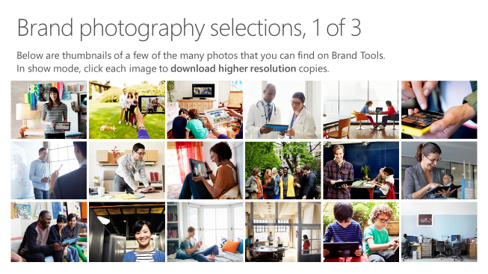
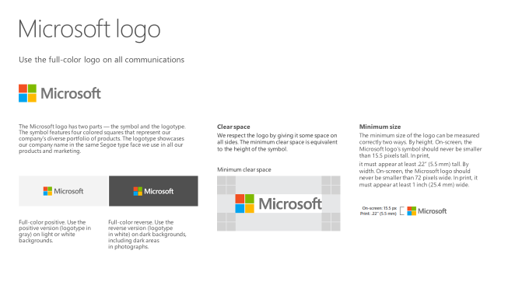
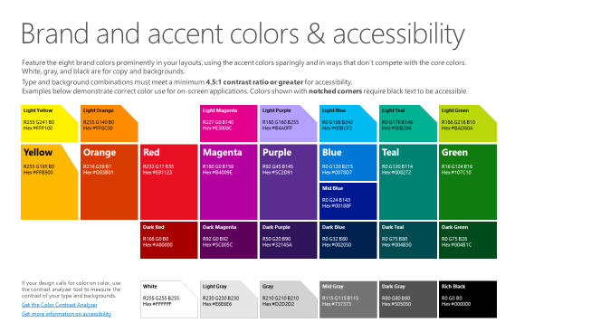
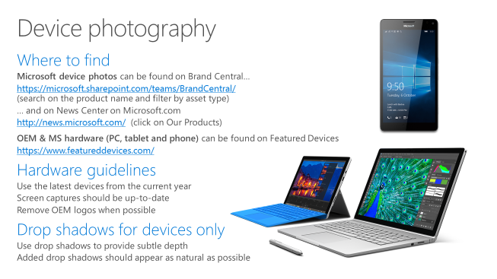
Microsoft brand guidelines
Looking for more slide resources?
Brand guidelines for PowerPoint templates is a separate slide deck that provides an overview of the Microsoft brand, guidelines, resources, tips and much more.
A few of the slides are shown
at right.
Download from: https://microsoft.sharepoint.com/teams/BrandCentral/Pages/Presentations.aspx

Slide 9
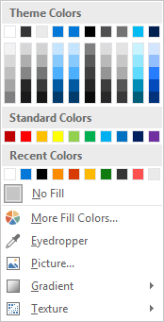
Slide palette info
The PowerPoint palette for this template has been built for you and is shown below. Avoid using too many colors in your presentation.
Accent colors 1-6 – (6 Theme Colors to the far right)
Accent 1
Accent 2
Accent 3
Accent 4
Accent 5
Accent 6
Use Accent 1 as the main accent color. Use Accent 2 and Accent 3 when additional colors are needed.
Use Accents 4-6 sparingly – only when more colors are necessary.

Slide 10
Demo
Speaker name

Slide 11
Video

Slide 12
Section title

Slide 13
Section title

Slide 14
Section title

Slide 15
Software code slide
This slide layout uses Consolas, a monotype font which is ideal for showing software code.

Slide 16
Notes (hidden)
Some speakers at Microsoft like to use this slide for hidden “notes slides”.
Delete it if you don’t want to use it.
NEXT: <next slide title>

